Slide 1

“How MUCH Faith Does
it Take?”
”需要多少信心?”

Slide 2
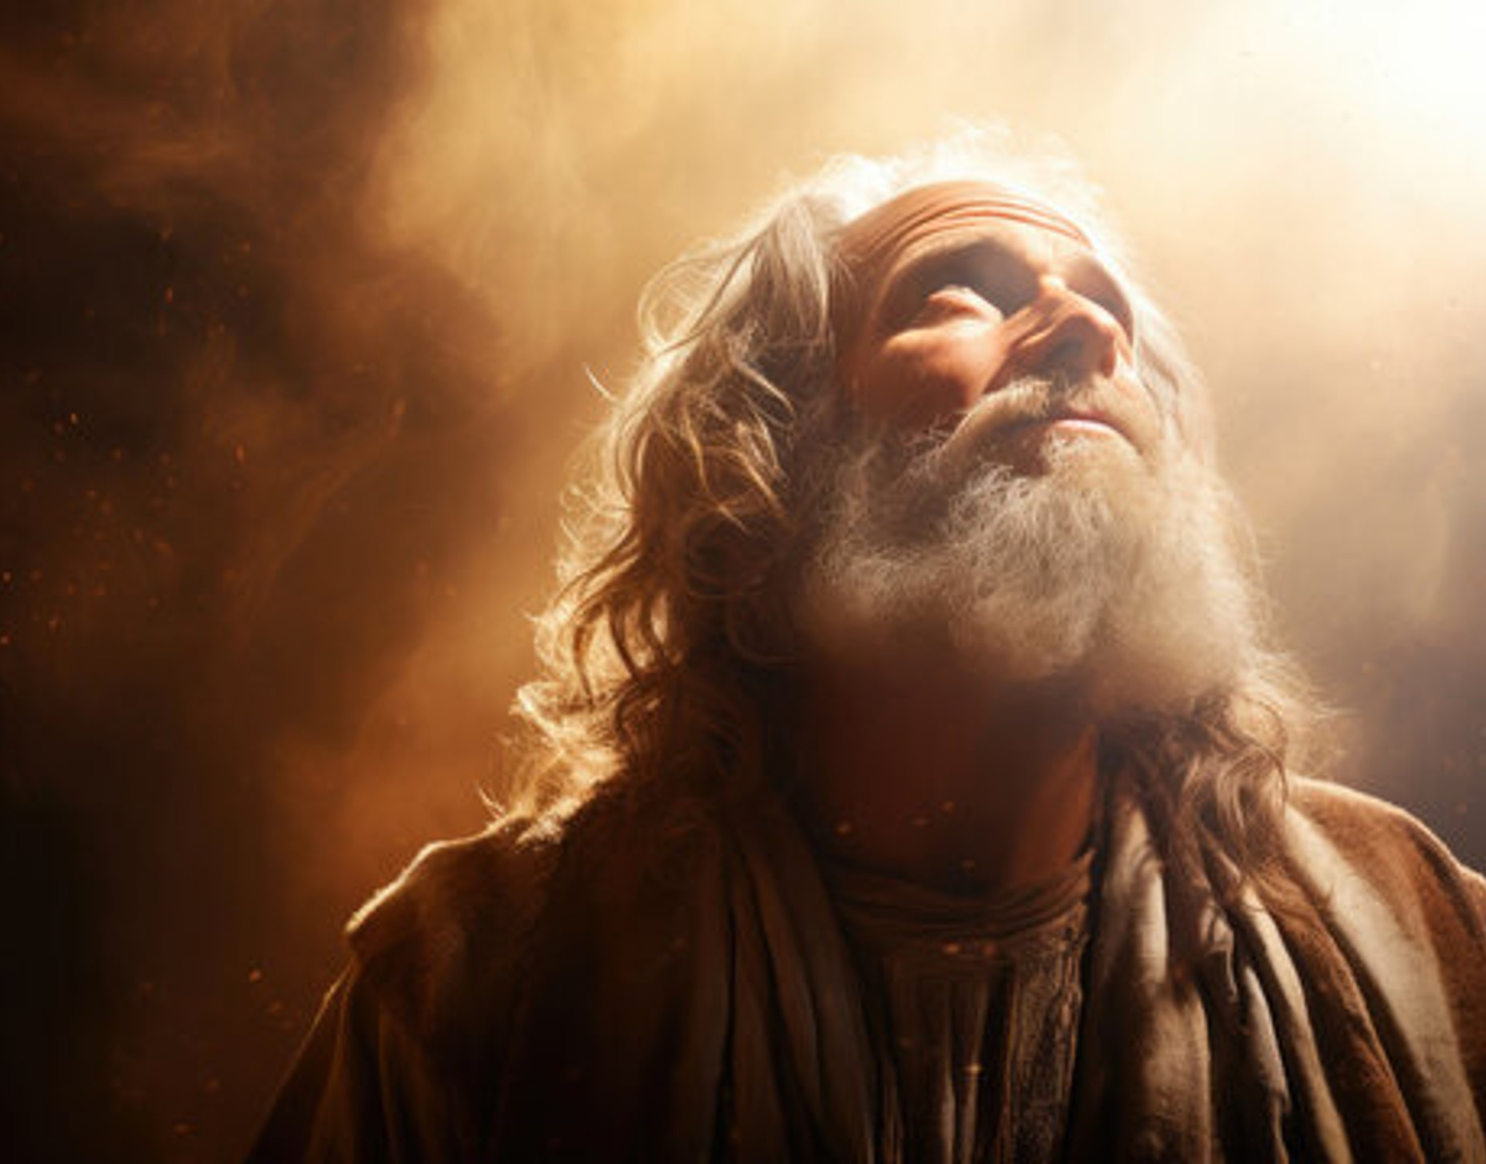
REMEMBER:
Faith is
記住：
信心就是
believing what GOD said.
相信神所說的話

Slide 3

Faith is a Partnership
信心是一種
夥伴關係

Slide 4
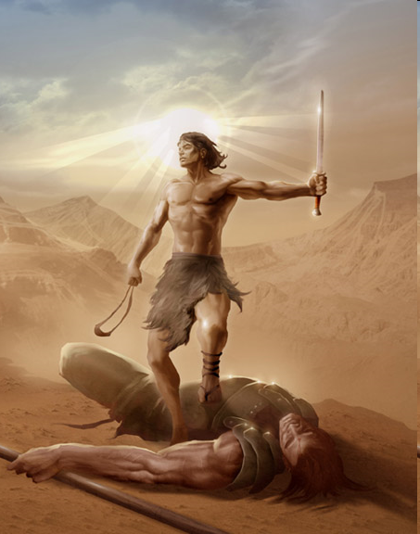
I cannot without Him.
沒有祂，我不能
He WILL NOT without me.
沒有我，祂也不成就這事
Ezekiel 以西結書22:20-21,
2 Chron. 歷代志下16:9

Slide 5


The Devil wants to destroy our Faith.
魔鬼试圖摧毁我们的信心
GOD wants to build it.
上帝要建立我們的
信心

Slide 6
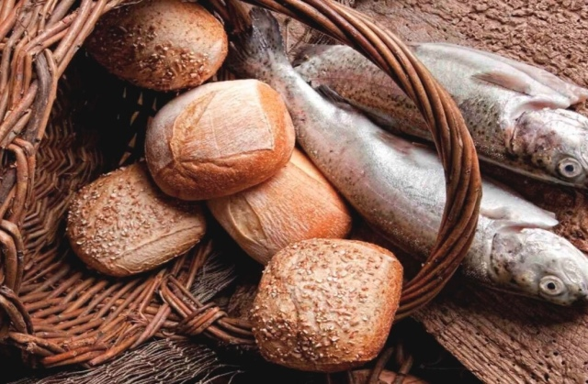
I Supply:
我獻上
He Supplies:神供應
My Need.
我的需要
John 約翰福音6:5-9
His Compassion 他的憐憫
My Trust (Faith) 我的信靠(信心)
Phil 腓立比書4:19
His Power 他的大能

Slide 7
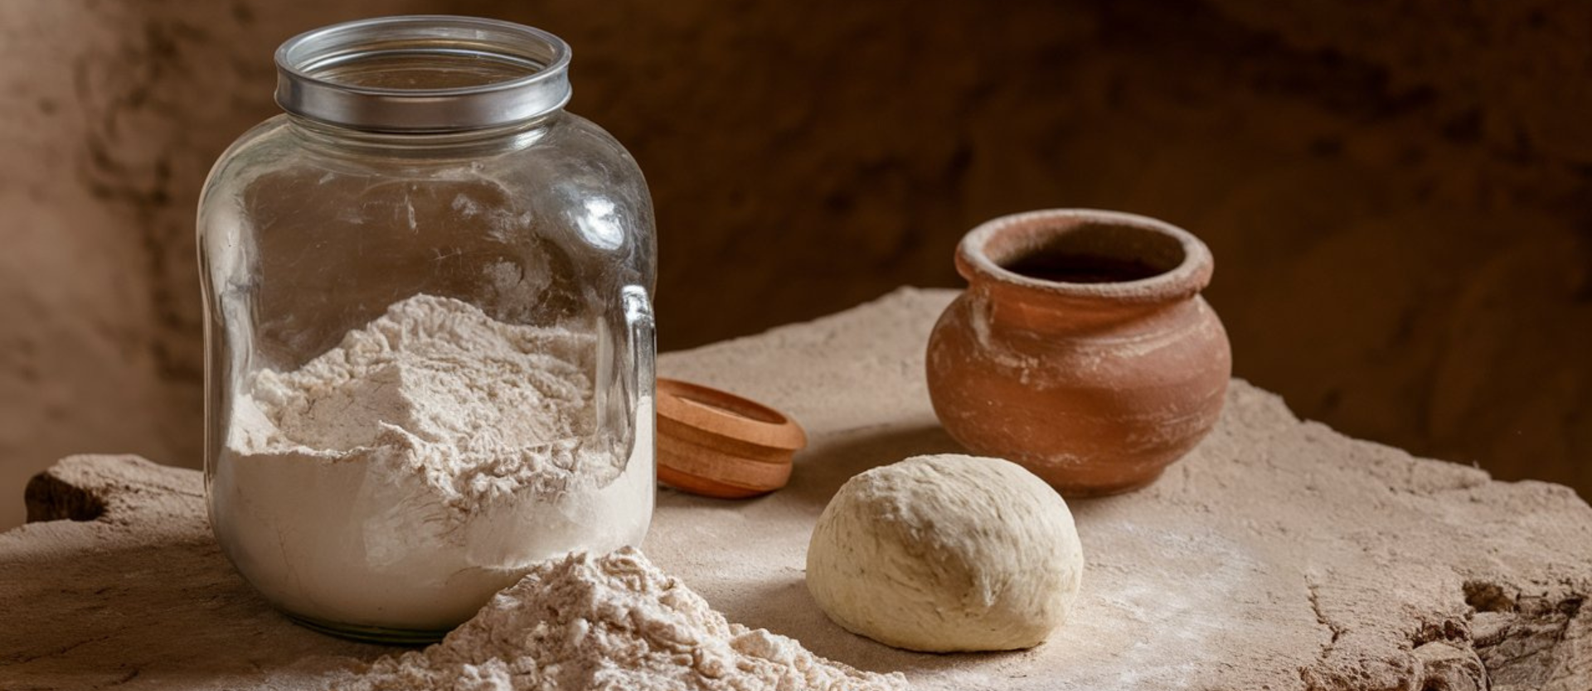
I Supply:
我獻上
He Supplies:
神供應
My Little (Sacrifice)
我的微小(奉獻)
Luke 路加福音6:38
His Abundance
他的豐盛
My Obedience
我的順服
I Kings 列王纪上 17:13
His Miracle他的神蹟

Slide 8
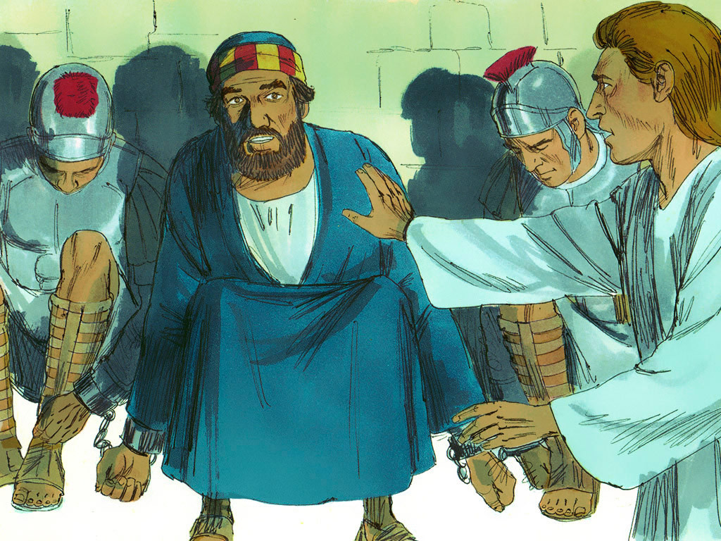
You have enough faith, IF you have enough faith to:
你有足夠的信心，
如果你有足夠的信心去:
I. PRAY 禱告
Acts 使徒行傳
12:1-17

Slide 9

2. Keep praying, in spite of your doubts.
不住禱告，哪怕有疑惑
1. The most powerful position on earth is praying before the Throne of GOD. 世上最強大的地位，就是在神的寶座前禱告。 Hebrews 希伯来书 4:16

Slide 10

3. HE hears you when you pray;
他聆聽你的禱告
Always.
永遠如此

Slide 11
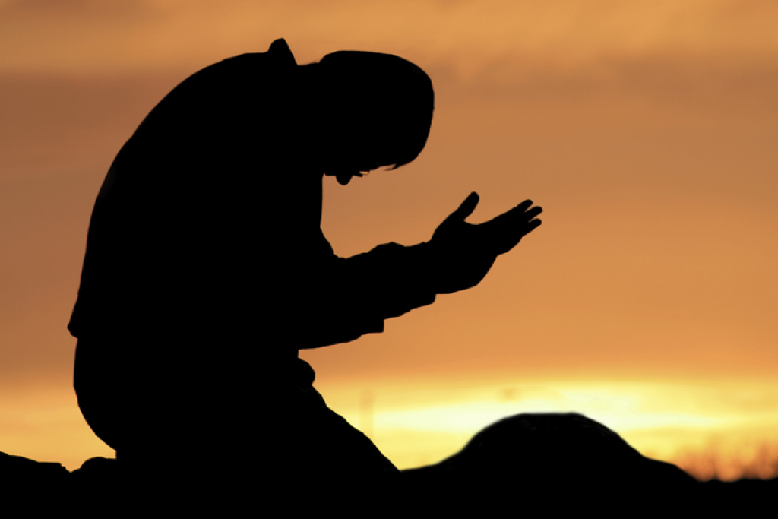
4. Expect your prayers to be answered.
期待你的禱告得蒙應允
It pleases HIM. 這使祂喜悦
Mark 马可福音 11:24

Slide 12
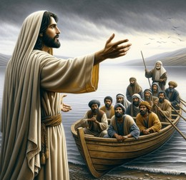
II. Obey 顺服
Luke 路加福音 5:1-8
5. The only way to know if you have faith,
判斷你是否有信心的唯一方法，

Slide 13
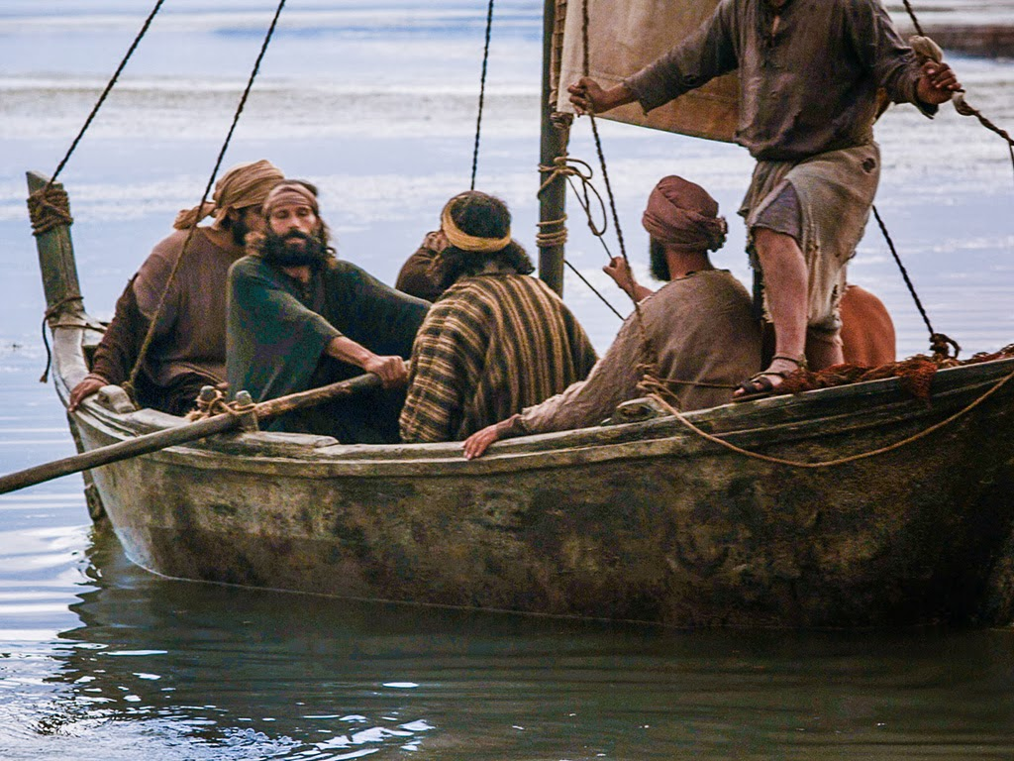
- is by what you are doing.
- 是看你在做什麼

Slide 14
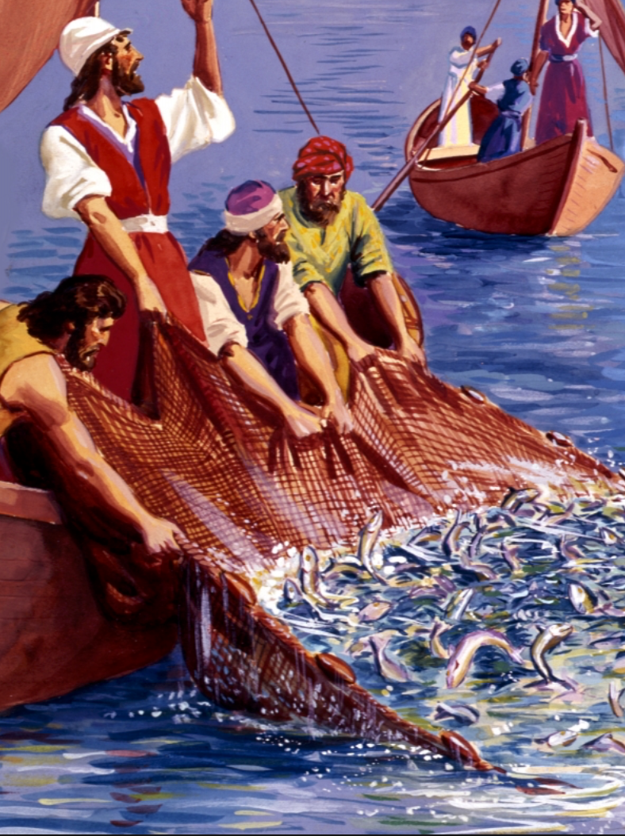
6. Faith is not a feeling.
信心不是一種感覺
It is belief that motivates you to action.
而是一种種激發你採取行動的信念

Slide 15
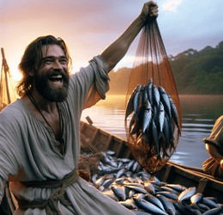
“Faith without Works is Dead”
“信心若没有行為就是死的”
James 雅各书 2:17

Slide 16
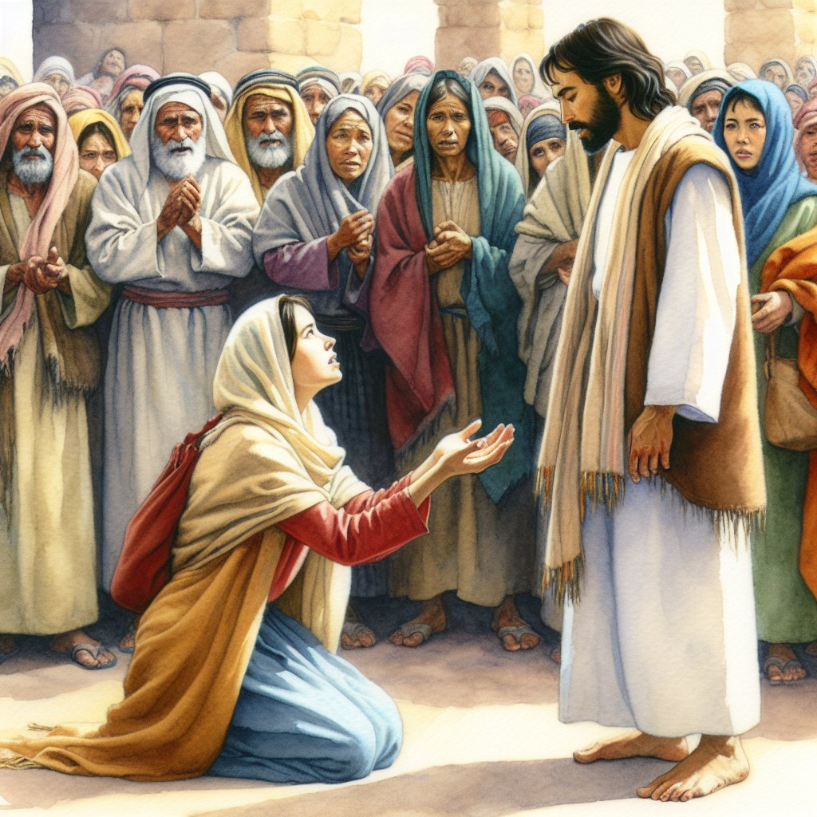
III. Stay 堅守
Matthew 馬太福音 15:21-28
7. People who walk in victory have doubts, too.
活在得勝中的人也會有疑惑
They just don’t let the doubts stop them.
他們只是不讓疑惑攔阻他們

Slide 17

8. If I do not get the answer I want, I will say,
如果我没有得到想要的答案，我會说，
“I trust GOD,
我信靠神
and HE knows what is best.”
祂知道什麼是最好的

